Slide 1
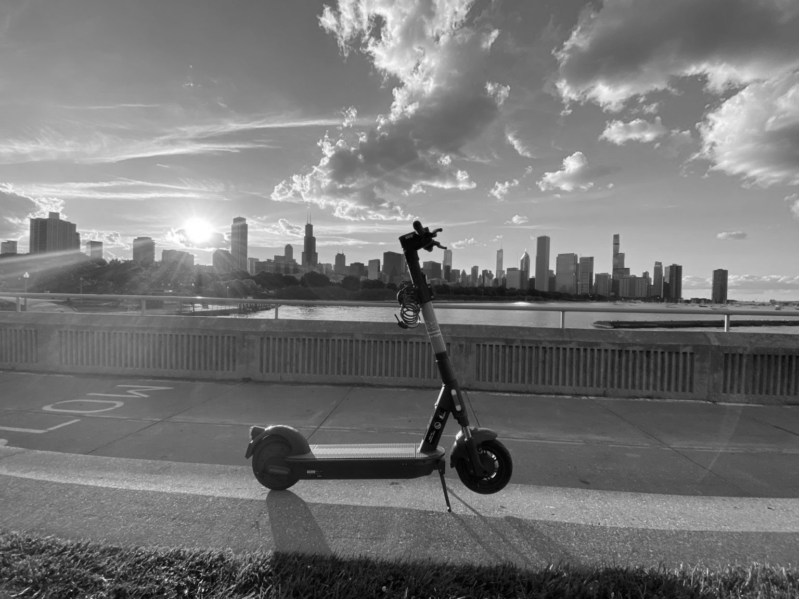



Forecasting Demand
in Chicago’s Emerging E-Scooter Market
Using Spatiotemporal Analysis
CAPSTONE 2024
THEIN-AN BUI HUSSEIN ABOU NASSIF MOURAD CATHY OUYANG ANARGHA AJOYKUMAR
ADVISOR: FAN YANG

Slide 2




Meet the team
Anargha Ajoykumar
Hussein Abou Nassif Mourad
Thien-An Bui
Cathy Ouyang

Slide 3


Shared electric scooters are a growing market
$1B
2022
$3B
2028
Projection*
Global e-scooter Market size
Chicago's emerging e-scooter market is ripe for growth, with companies vying for market share and optimizing strategies in this sector.
45% of Chicago riders in 2020 expressed a desire for increased e-scooter availability, signaling strong unmet demand
*Grand View Research. E-Scooter Sharing Market Size & Trends Report, 2022 - 2028. (n.d.).

Slide 4






Accurate demand forecasts lead to significant savings
E-scooter providers have an opportunity to appropriately respond to customer needs using robust demand forecasting insights
E-Scooter Company
More users, less e-scooters
Missed Revenue Opportunities
Loss of Potential customer base
Demand met
More e-scooters, less users
Revenue loss
Increased Operational Cost
“E-scooter companies won’t be competing on price alone: they will be fighting over turf and e-scooter availability. To win over a city, they will need to make more e-scooters available in a wider radius than competitors and account for customer demand.” – Boston Consulting Group

Slide 5
We tackled this opportunity with a four-step methodical approach
DATA PROCESSING & EDA
MODEL DEVELOPMENT
MODEL SELECTION
DEMAND & SUPPLY DERIVATION
1
2
3
4
Data processing and Exploratory Data Analysis to derive basic insights
Develop appropriate algorithms for predicting the number of trips and test them
Evaluate each of their performance using metric RMSE and select the model with lower RMSE
Calculate demand and supply based on the forecasted trip count

Slide 6

















Our dataset contains several spatiotemporal fields from the original source as well as additional fields from external datasets
Total Count: 3.8M Trips
May 2022 - Sept. 2023
Train: May 2022 - June 2023
Test: July 2023 - Sept 2023
Time Series Period: 1 Hour
Seasonality
Trend
Non-Stationary
Independent Variables from Original Dataset
Additional Independent Variables from External Datasets
Dependent Variable
Start/End Times
Trip Distance
Weather
Demographics
Count of Trips
Start/End Community
Trip Duration
Crime
Bus stops
Latitude/Longitude
Vendor
Gas Price
Train stops

Slide 7
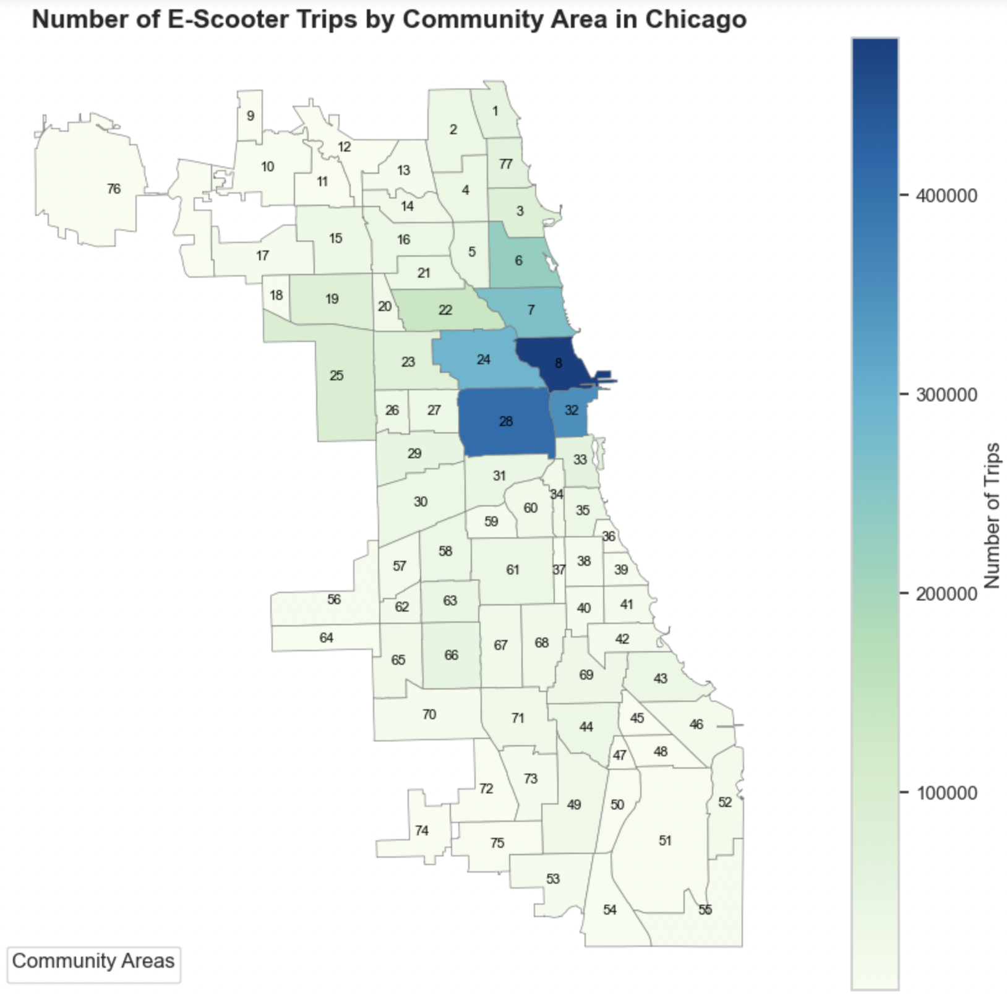
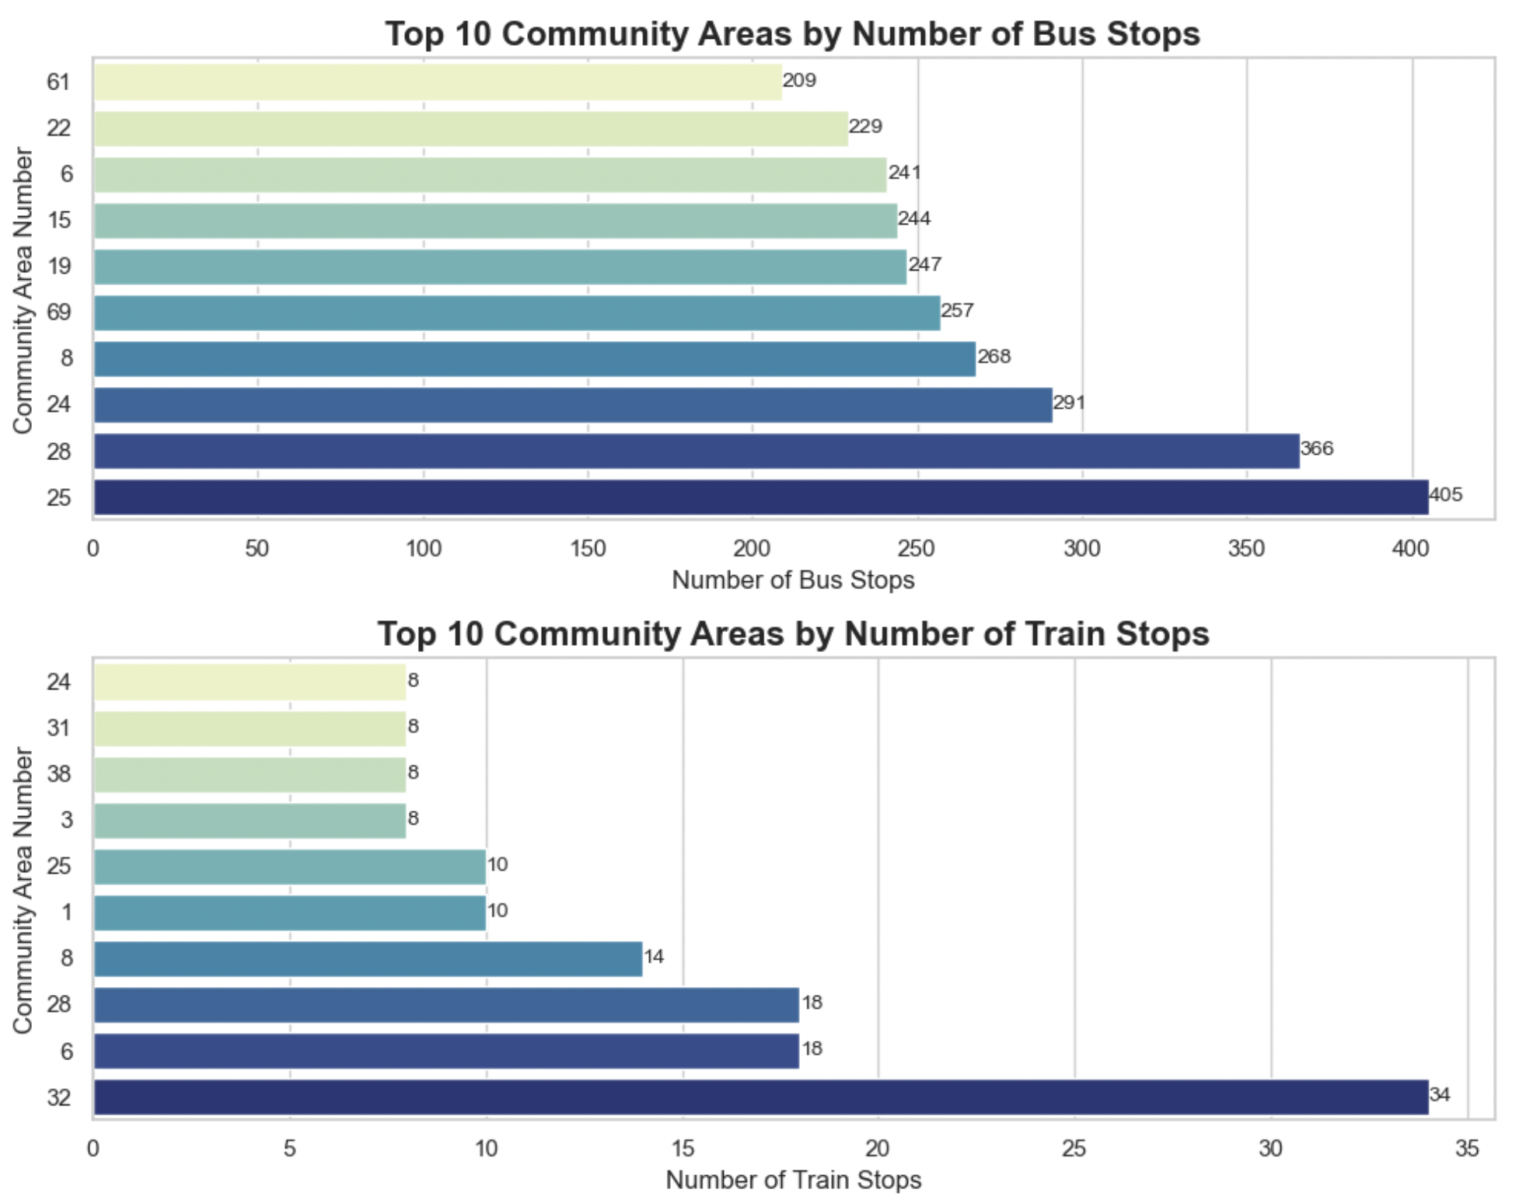
Community 8 (Near North Side) sees most of the trips
Communities with highest trip count
8 (Near North Side)
28 (Near West Side)
32 (The Loop)
Communities with the highest trip count are the most commercially dense
Communities with the highest trip count showed higher median income
Communities with the highest trip count showed a moderate crime rate
Communities with the highest trip count have highly educated residents

Slide 8
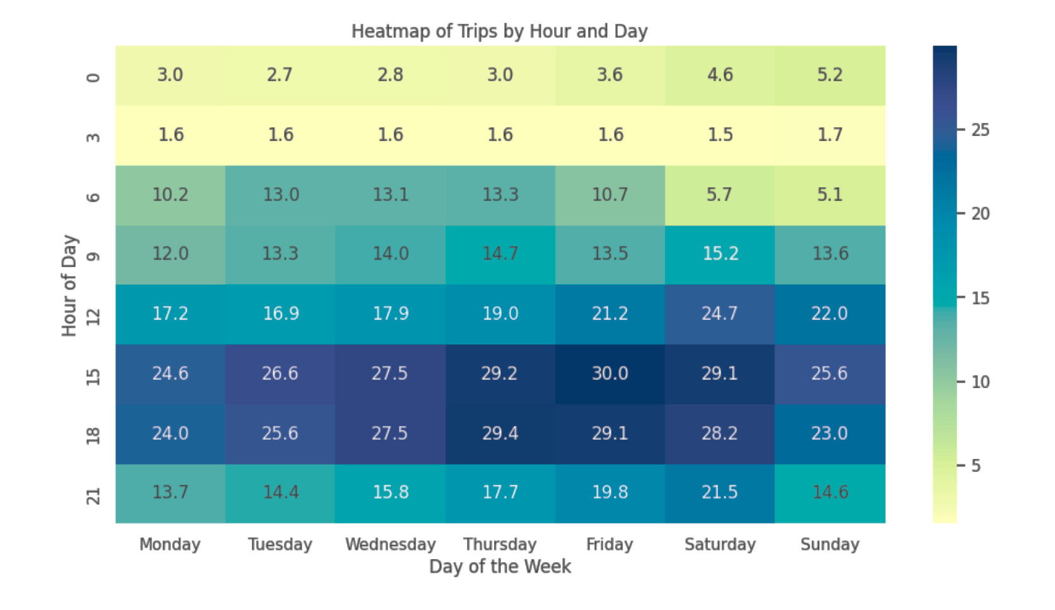
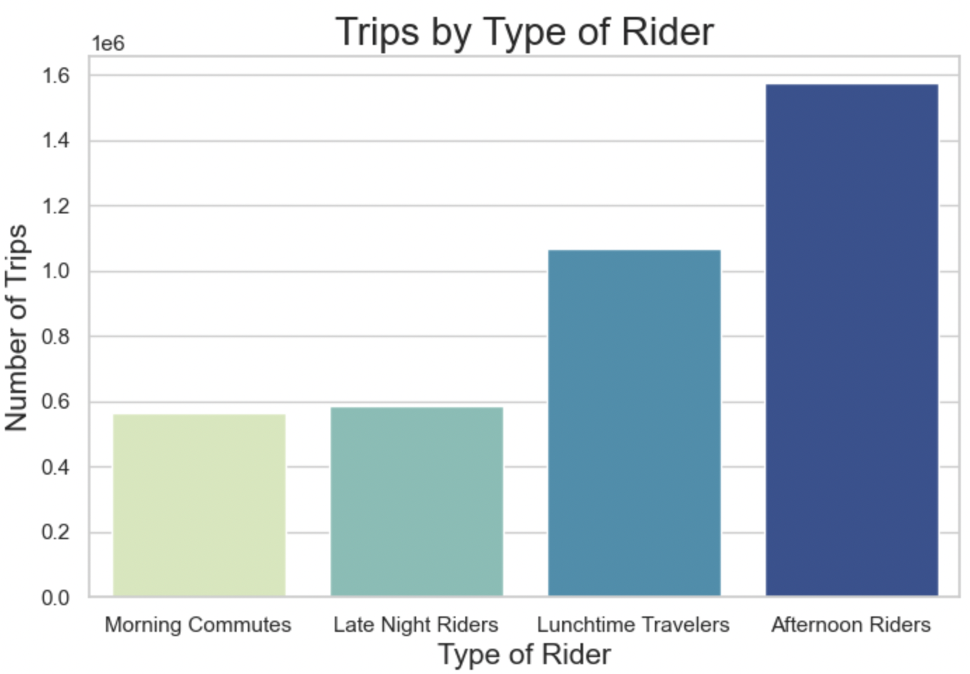
Afternoon riders are the most common customer
Morning Commutes: 5AM - 10AM
Lunchtime Travelers: 10AM - 3PM
Afternoon Riders: 3PM - 8PM
Late Night Riders: 8PM - 1AM
** 1-5AM omitted due to extremely minimal rider activity during these hours **
The highest trip counts occur during the afternoon and early evening, specifically at 3 PM (15:00) and 6 PM (18:00)
Fridays show the highest number of trips overall, especially in the afternoon hours (3 PM and 6 PM)

Slide 9
We selected the modeling approaches below due to their specific features that align with our scenario
Deep AR
LSTM
Prophet
XGBR
Cross-learning capabilities allow this model to capture complex, group-dependent relationships and aggregate them within the main times series model.
The model is built to handle sequential datasets and can deal with seasonality. LSTM can also capture long-term dependencies. These are all characteristics that we see in our dataset.
A time series analysis tool by Meta, ideal for forecasting with complex seasonality, like hourly, daily, or weekly patterns, and can handle multivariate data and missing values.
Effective in capturing complex relationships in structured data. The model's robustness to outliers and ability to handle large datasets ensure accurate and reliable forecasts.

Slide 10


All models outperformed the naive baseline; LSTM performed the best with its lowest RMSE score
We chose RMSE due to its straightforward interpretation and robustness to outliers
Models | RMSE
Deep AR | 11
LSTM | 8
Prophet | 9
XGBR | 11
Naive Baseline (24-Hour Moving Average) | 25
PROPHET
DEEP AR
LSTM
XGBR
Other models we tried that did not work: ARIMAX, SARIMAX, Darts, Regression, Random Forest

Slide 11
LSTM (Long Short-Term Memory) was run for each community separately to predict future e-scooter trip count
Parametric model that handles sequential data while dealing with seasonality and capturing long-term dependencies
LSTM layer 1
Weights (Input, recurrent, bias), ReLU activation
Input data (Historical trips data, Exogenous variables)
Scaling Data
MinMax Scaler
LSTM layer 2
Weights (Input, recurrent, bias), ReLU activation
Adam optimizer minimizes loss function and updates weights
Dense Layer Output
Trips Count
Early Stopping

Slide 12
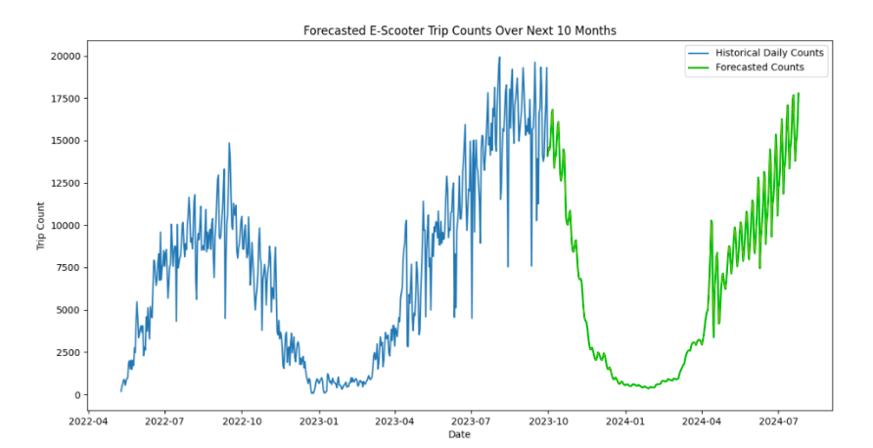
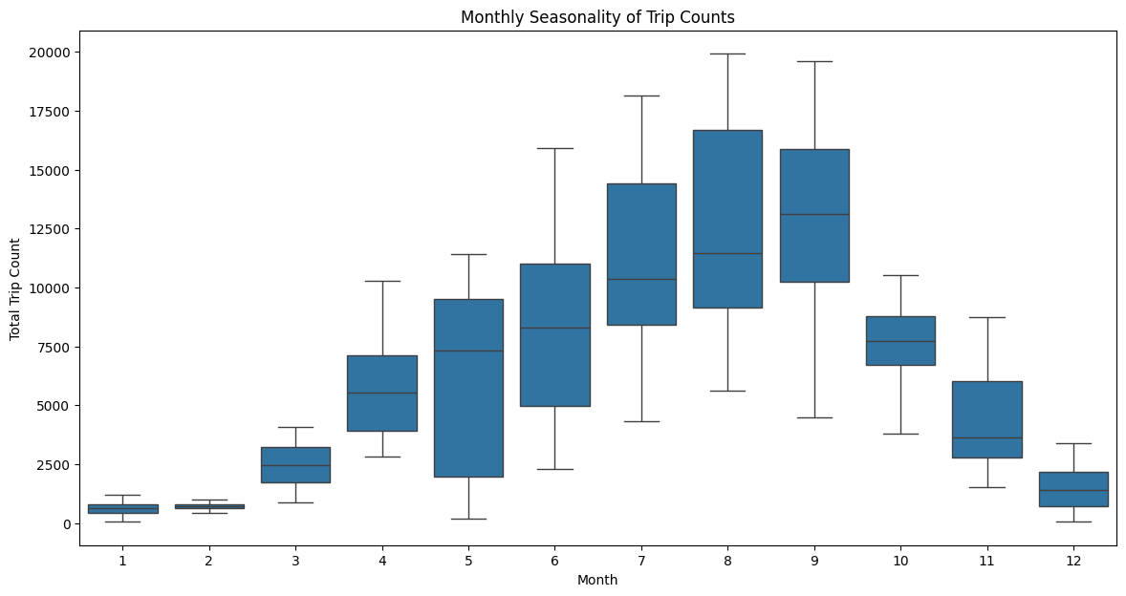
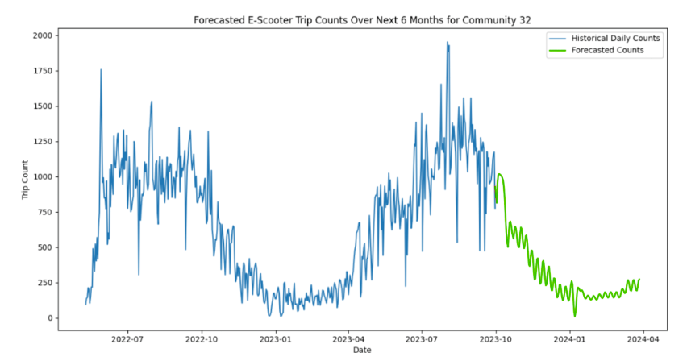

Our aggregate model shows continued seasonality with an upward trend in e-scooter trip counts
Revenue Projection: 3 - 5%
The average price per ride or rent: $8 ($1 unlock fee and a $0.39 per-minute charge* calculated for 19 minutes average trip duration)
Predicted Revenue is determined from the average price and trips predicted
% increase in revenue is calculated as the difference between the predicted revenue and the actual revenue, expressed as a percentage.
*Based on 2020 pilot program

Slide 13




The Demand and Supply Formulation helped identify peak demand and supply areas
Companies should focus on Communities
14 (Albany Park),
45 (Avalon Park)
67 (West Englewood)
These triggered the low supply index and had a high demand index flag
Supply index calculation using backpropagation
Output data including trip counts and indices values fed to R shiny dashboard
2
4
14 (Albany Park) - Home to two medium sized universities. During the pilot program, college-aged students were among the highest users of e-scooters.
45 (Avalon Park) – Residential area with parks, churches, and small businesses. In the pilot program, attending recreational activities was a top reason for e-scooters.
67 (West Englewood) - Community surrounded by other populous communities, which increases the need for e-scooters when traveling around the area.
1
3
Hourly e-scooter trip counts at community-level from the model output
Unmet demand index calculation from supply & pattern check

Slide 14
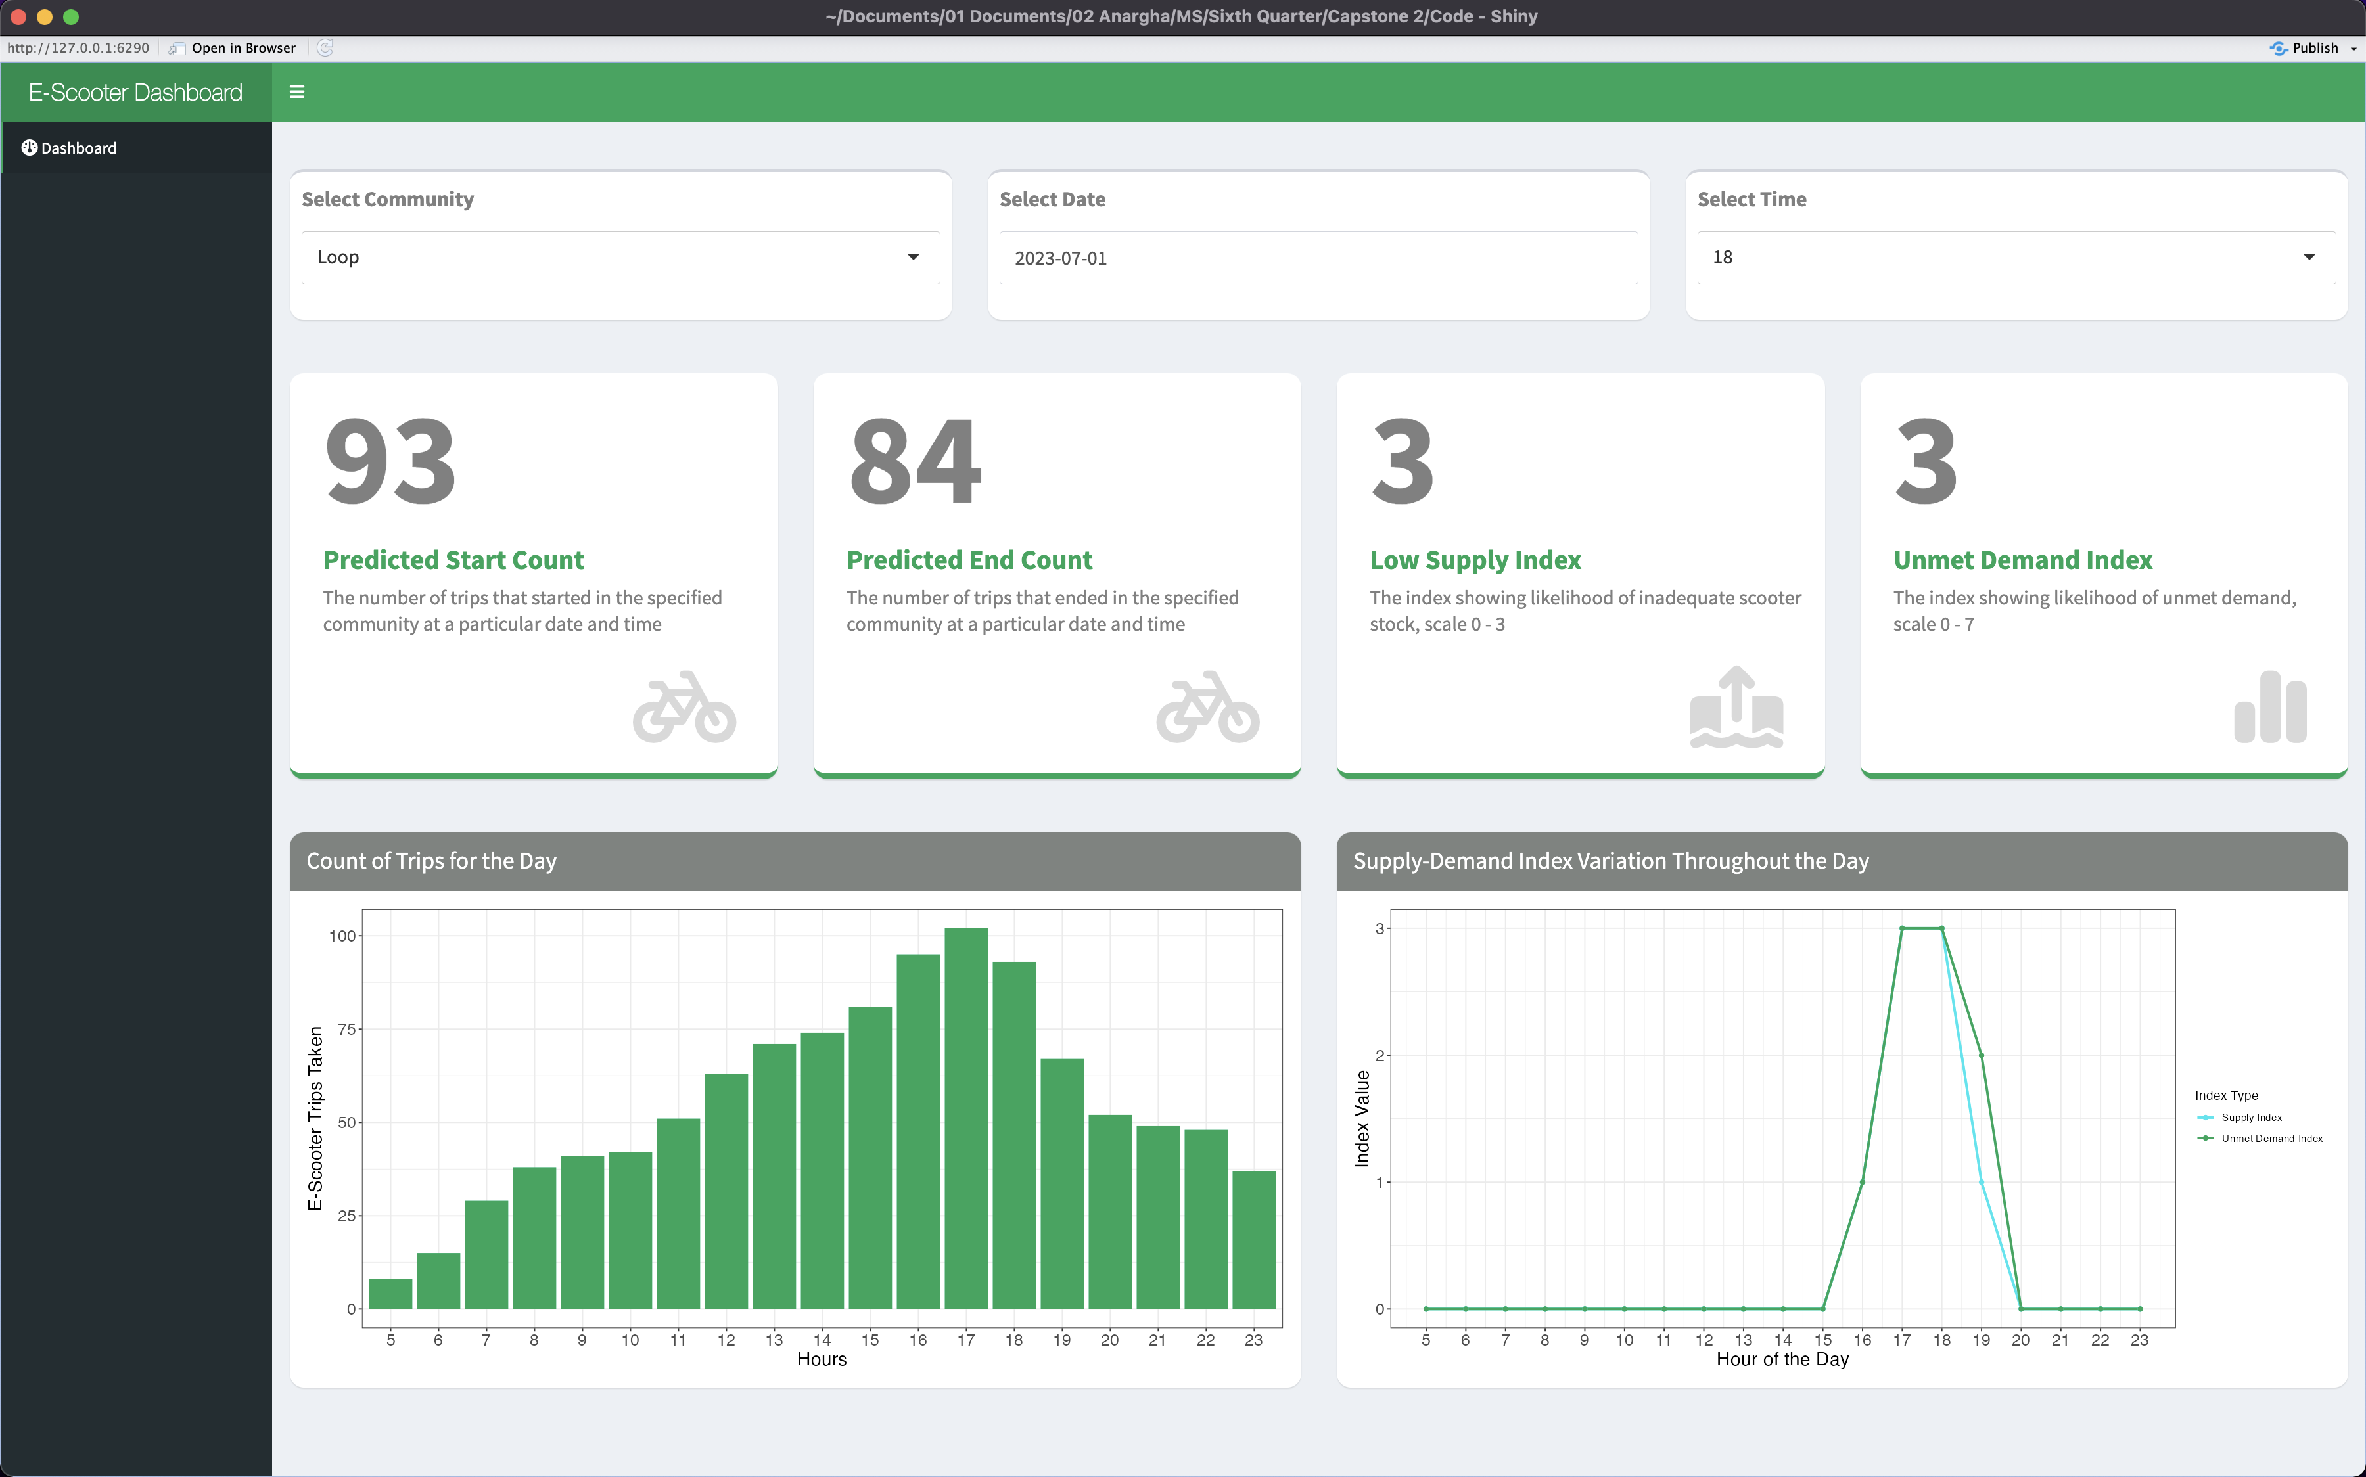
The R Shiny dashboard offers insights into the supply-demand metrics for each community at specific dates and times

Slide 15





We encountered roadblocks, but resolved them together
Our original scope sought to be exhaustive. We realized our time frame was inadequate to do so.
Solution: We narrowed the project’s scope after defining our work as a proof of concept
We did not have access to supply information when attempting to provide recommendations for optimal supply strategies.
Solution: We derived a baseline supply calculation based on the available data
Several exogenous variables we planned to utilize were time-independent (i.e. demographics). Since they are static, they will not be useful for our model.
Solution: Retained only the 6 time-dependent exogenous variables when forecasting
Handling 3.8M trip-level records and merging it with six external sources was quite challenging Solution: Aggregated the data into 1-hour interval, which made the merging process faster and more efficient

Slide 16




We recommend companies follow several steps to achieve success in Chicago’s e-scooter market
The LSTM model produced the best model based on its RMSE score of 8
Focus marketing and operational efforts on community areas with the highest projected revenues to maximize returns
1
4
Vendors should consider placing more scooters in the following communities:
14 (Albany Park), 45 (Avalon Park), 67 (West Englewood)
Allocate more e-scooters and charging stations to areas with higher projected revenues to meet demand effectively and increase operational efficiency
2
5
We predict to see a 3% - 5% increase in revenue for e-scooter vendors if they place more e-scooters in these communities to meet demand
Promote e-scooter use in growth-potential areas through local partnerships, events, and enhanced user experiences
3
6

Slide 17
If we hand off our work to an e-scooter company, our efforts can be advanced through increased data collection, more external variables, and simulation implementation
Leverage insights from demand forecasting models as parameters for Markov state simulation environments to determine optimal supply strategies
4
3
Explore potentially scaling this model for other micromobility devices, such as bicycles
Continuously monitor the demand patterns and adjust strategies accordingly. Seasonal variations, new developments, or changes in local policies could affect demand
2
Continue to incorporate additional external variables that could contribute to e-scooter availability to improve prediction accuracy
1
Current state: We have a high-performing model that provides value to companies by predicting e-scooter counts, thus enhancing operational efficiency and enabling data-driven decisions
0

Slide 18
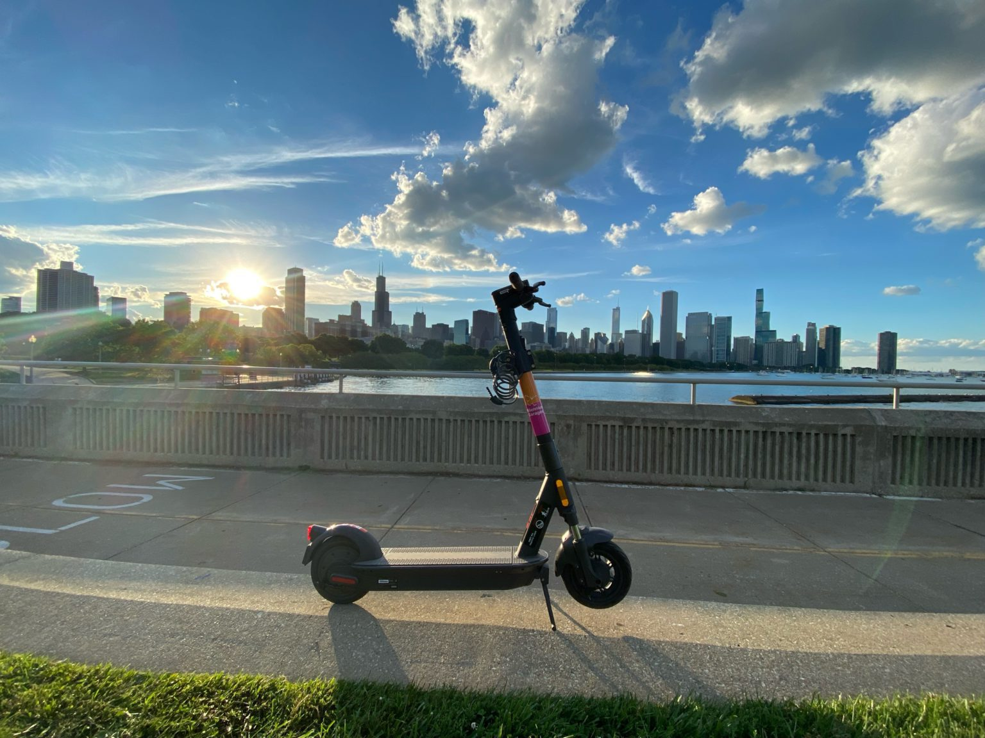

Thank YOU !!

Slide 19
Resources
Aarhaug, J., Fearnley, N., Hartveit, K. J. L., & Johnsson, E. (2023). Price and competition in emerging shared e-scooter markets. Research in Transportation Economics.
Abouelela, M., Chaniotakis, E., & Antoniou, C. (2023). Understanding the landscape of shared-e-scooters in North America; Spatiotemporal analysis and policy insights. Transportation Research Part A: Policy and Practice.
‌Caspi, O., Smart, M. J., & Noland, R. B. (2020). Spatial associations of dockless shared e-scooter usage. Transportation Research Part D: Transport and Environment.
City of Chicago. (2021, May). 2020 E-Scooter Pilot Evaluation.
Grand View Research. E-Scooter Sharing Market Size & Trends Report, 2022 - 2028. (n.d.).
Frequently asked questions: Scooters. Lyft. (n.d.).
G N,. (2020). ARIMAX Model for Short-Term Electrical Load Forecasting. International Journal of Recent Technology and Engineering (IJRTE).
Hawa, L., Cui, B., Sun, L., & El-Geneidy, A. (2021). Scoot over: Determinants of shared electric scooter presence in Washington D.C. Case studies on Transport Policy, 9(2), 418-430.
Ham, S. W., Cho, J.-H., Park, S., & Kim, D.-K. (2021). Spatiotemporal demand prediction model for E-scooter sharing services with Latent Feature and deep learning. Transportation
Research Record: Journal of the Transportation Research Board, 2675(11), 34–43.

Slide 20
Resources (cont.)
Jiao, J., & Bai, S. (2020). Understanding the Shared E-scooter Travels in Austin, TX. ISPRS International Journal of Geo-Information, 9(2), 135.
Kraus, R. (2019, January 10). Lyft and Lime are rolling out new scooter models. Mashable.
Kumar Dubey, A., Kumar, A., García-Díaz, V., Kumar Sharma, A., & Kanhaiya, K. (2021). - Study and analysis of SARIMA and LSTM in forecasting time series data. Sustainable Energy Technologies and Assessments.
Lyft. (2023, February 7). Meet Lyft’s Next-Gen Scooter.
Schellong, D., Sadek, P., Schaetzberger, C., & Barrack, T. (2019). The promise and pitfalls of e-scooter sharing.
Tuli, F. M., Mitra, S., & Crews, M. B. (2021). Factors influencing the usage of shared E-scooters in Chicago. Transportation Research Part A: Policy and Practice
Zhao, P., Li, A., Pilesjo, P., & Mansourian, A. (2022). A machine learning based approach for predicting usage efficiency of shared e-scooters using vehicle availability data. AGILE:
GIScience Series, 3, 1-10.

Slide 21

We leverage time series and forecasting models to derive e-scooter demand insights
We predict the demand for e-scooters across different locations and timeframes in Chicago then make policy recommendations for e-scooter companies based on these models
Community 2
Community 1
Accuracy Metrics
Community 77
Design model to predict trip count for community 1
Repeat the modeling for 77 communities
Aggregate the RMSE to derive the overall RMSE
1
2
3

Slide 22
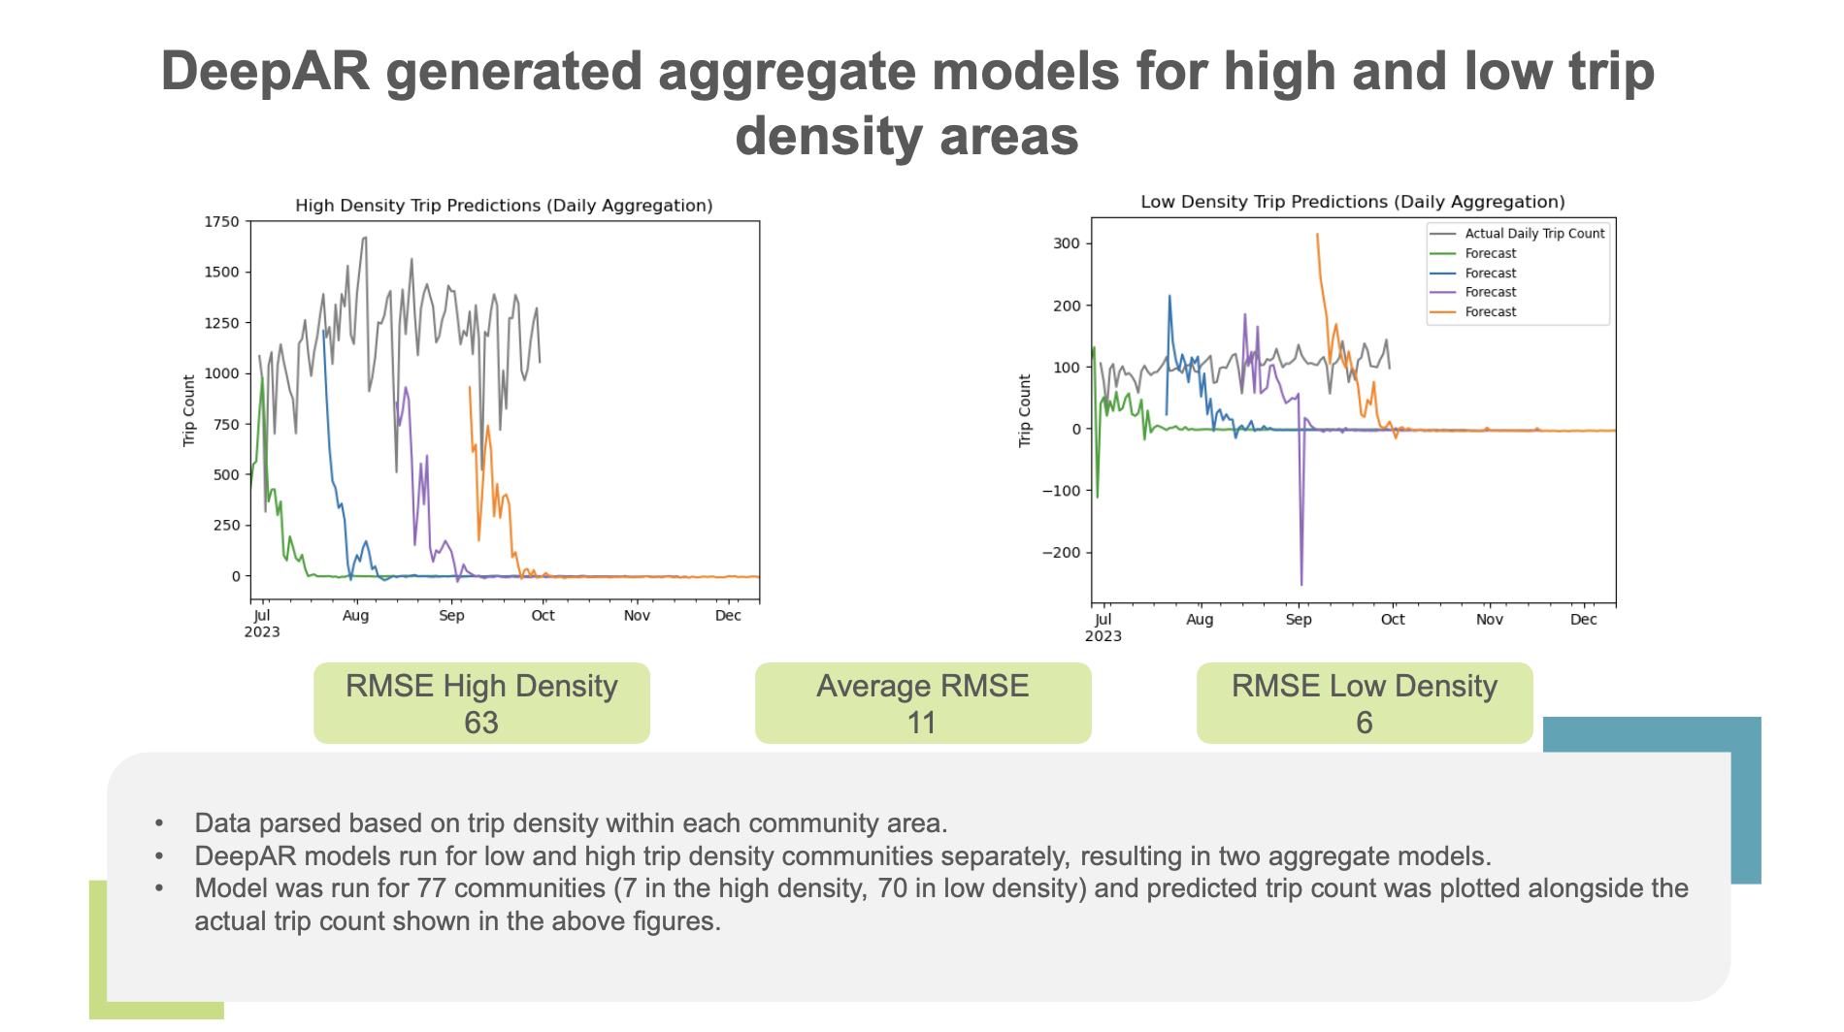

Slide 23
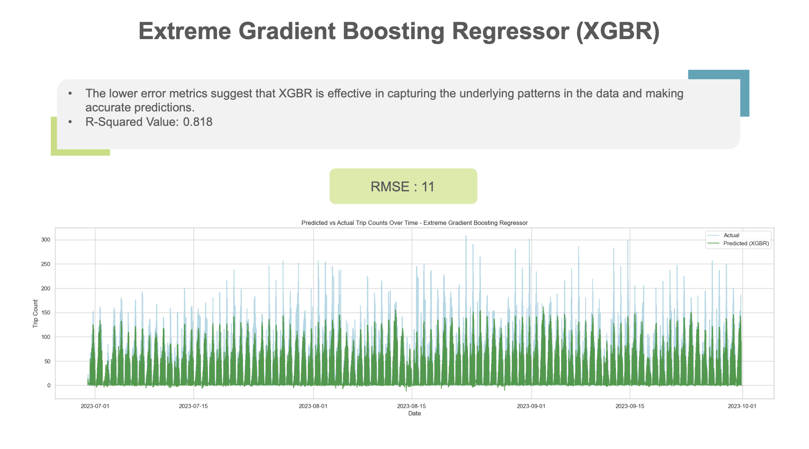

Slide 24
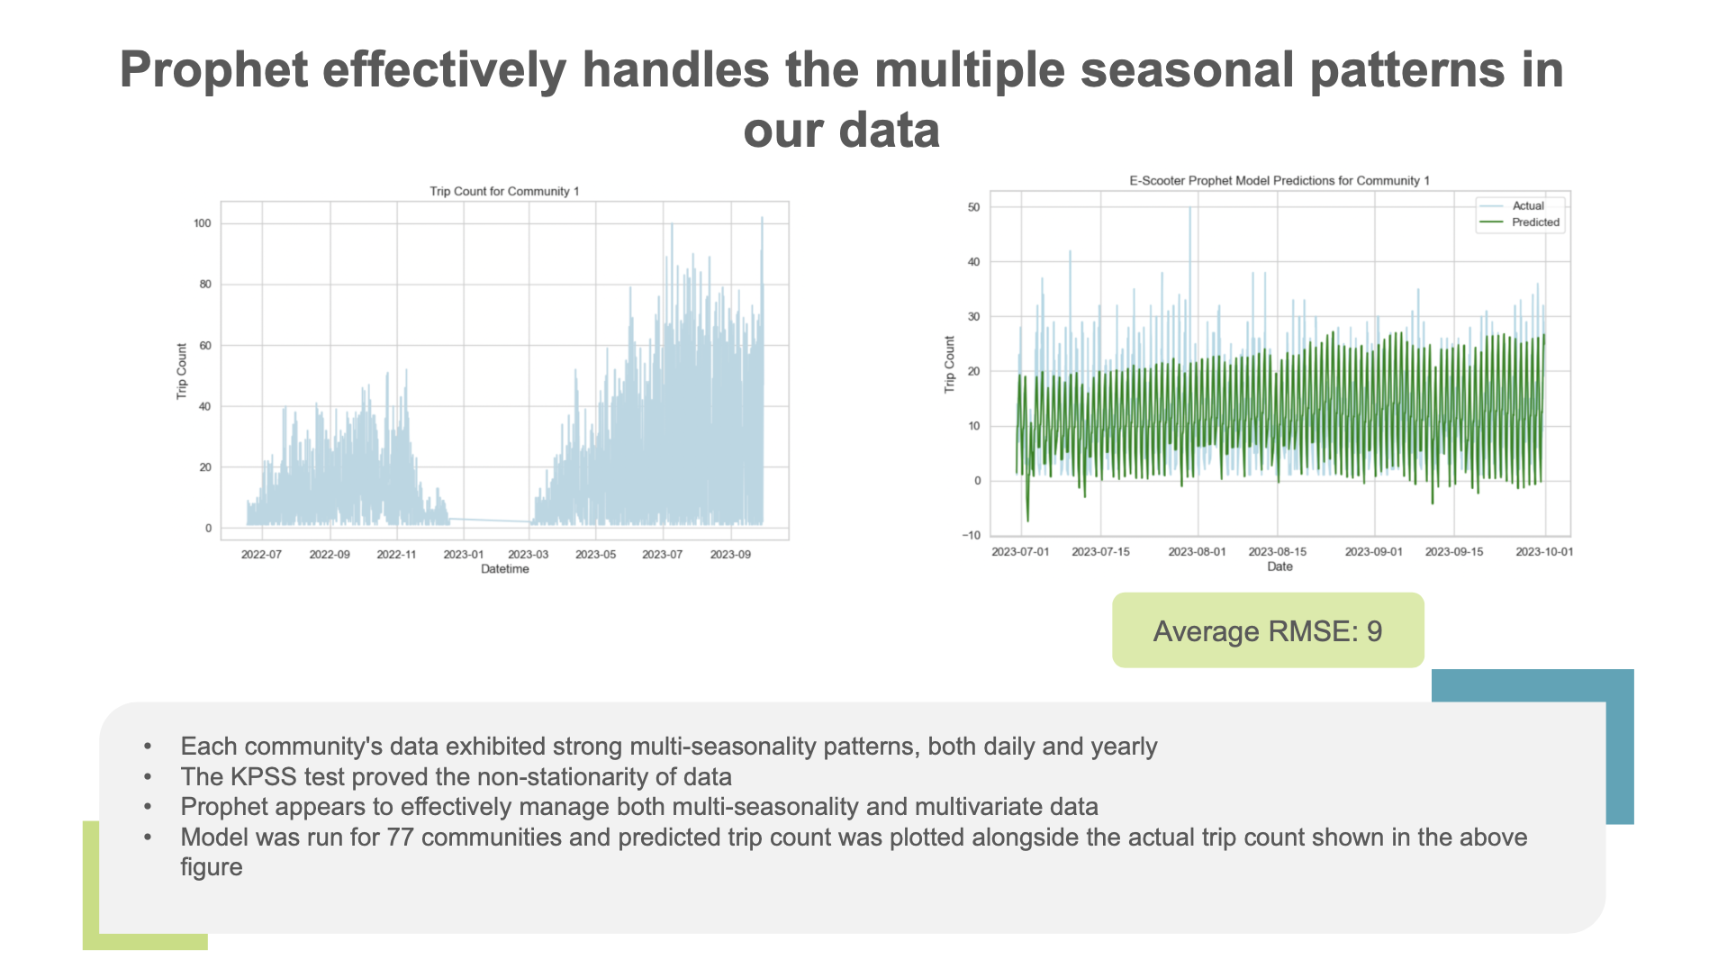

Slide 25
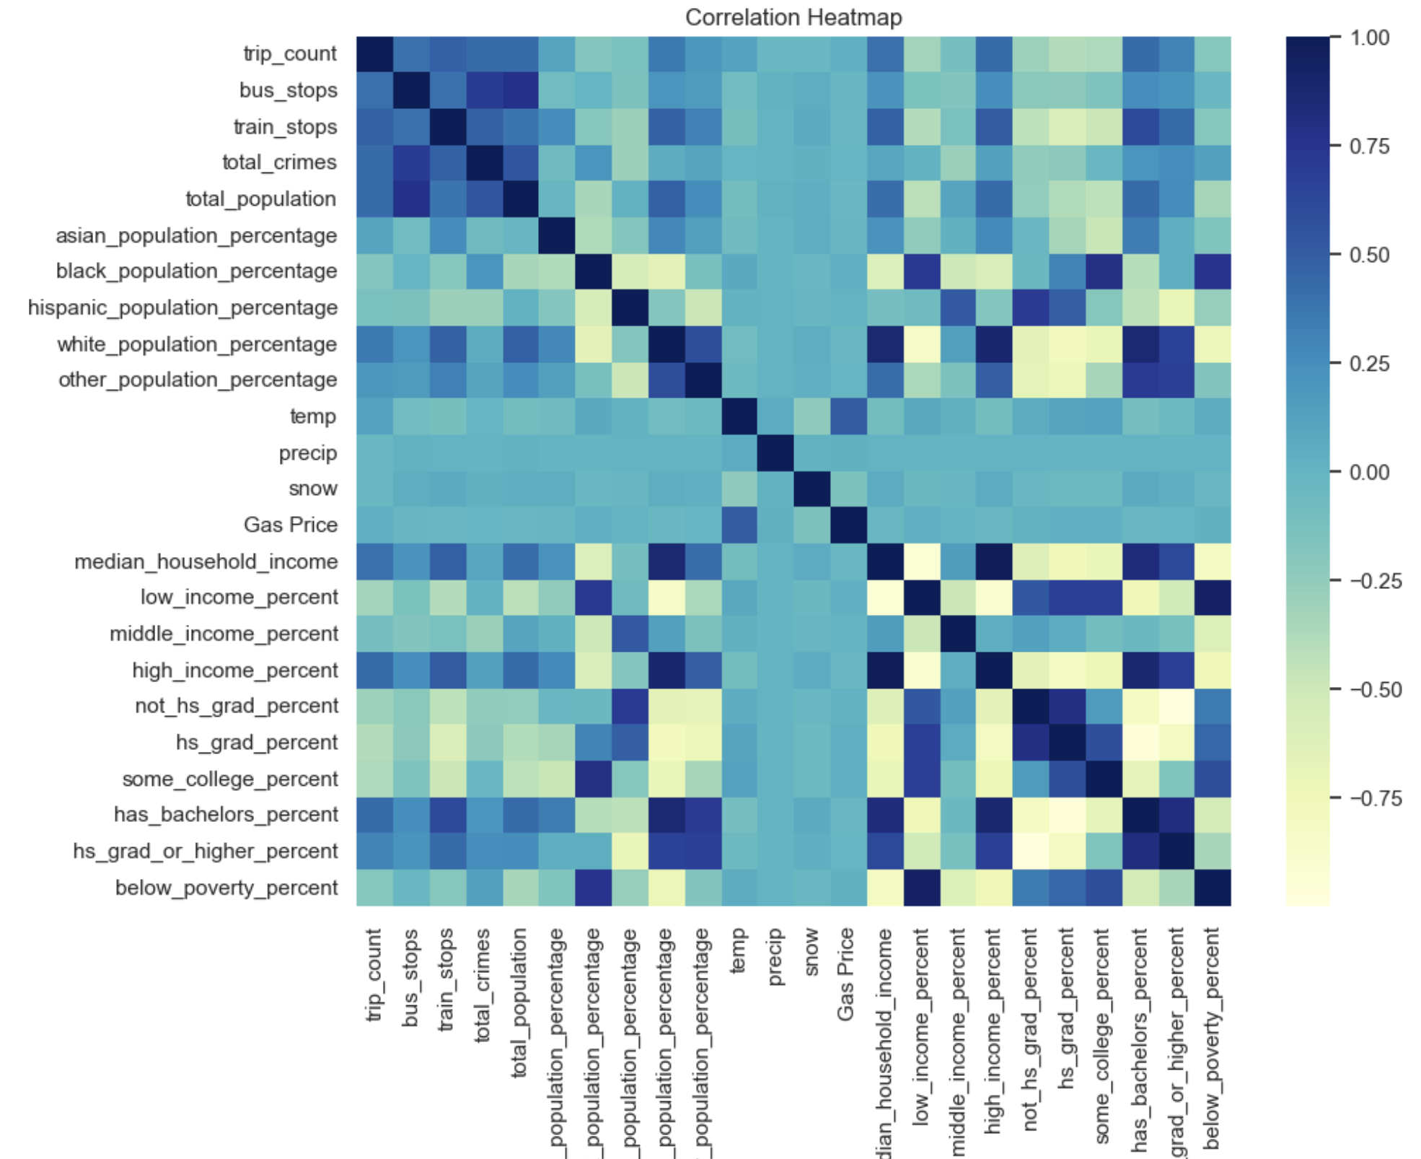
The following exogenous time dependent variables are correlated with higher trip count
Moderate temperature
Lower precipitation
Lower snow
Slightly higher gas prices

Slide 26
